Slide 1

Creating Empty Repository
Konkuk University, Department of Computer Science/Software
Jason. HW. Kang

Slide 2
Contents
1. Creating Github Account
2. Creating Empty Repository

Slide 3
Creating Account
1. Github is the web version of git.
2. It shows commit, it allows you to commit online, providing many features!

Slide 4
Creating Account
Go to https://github.com
Sign up!
Once you have signed up, you may want to acces https://github.com/id-you-chose eg: https://github.com/kangdroid

Slide 5
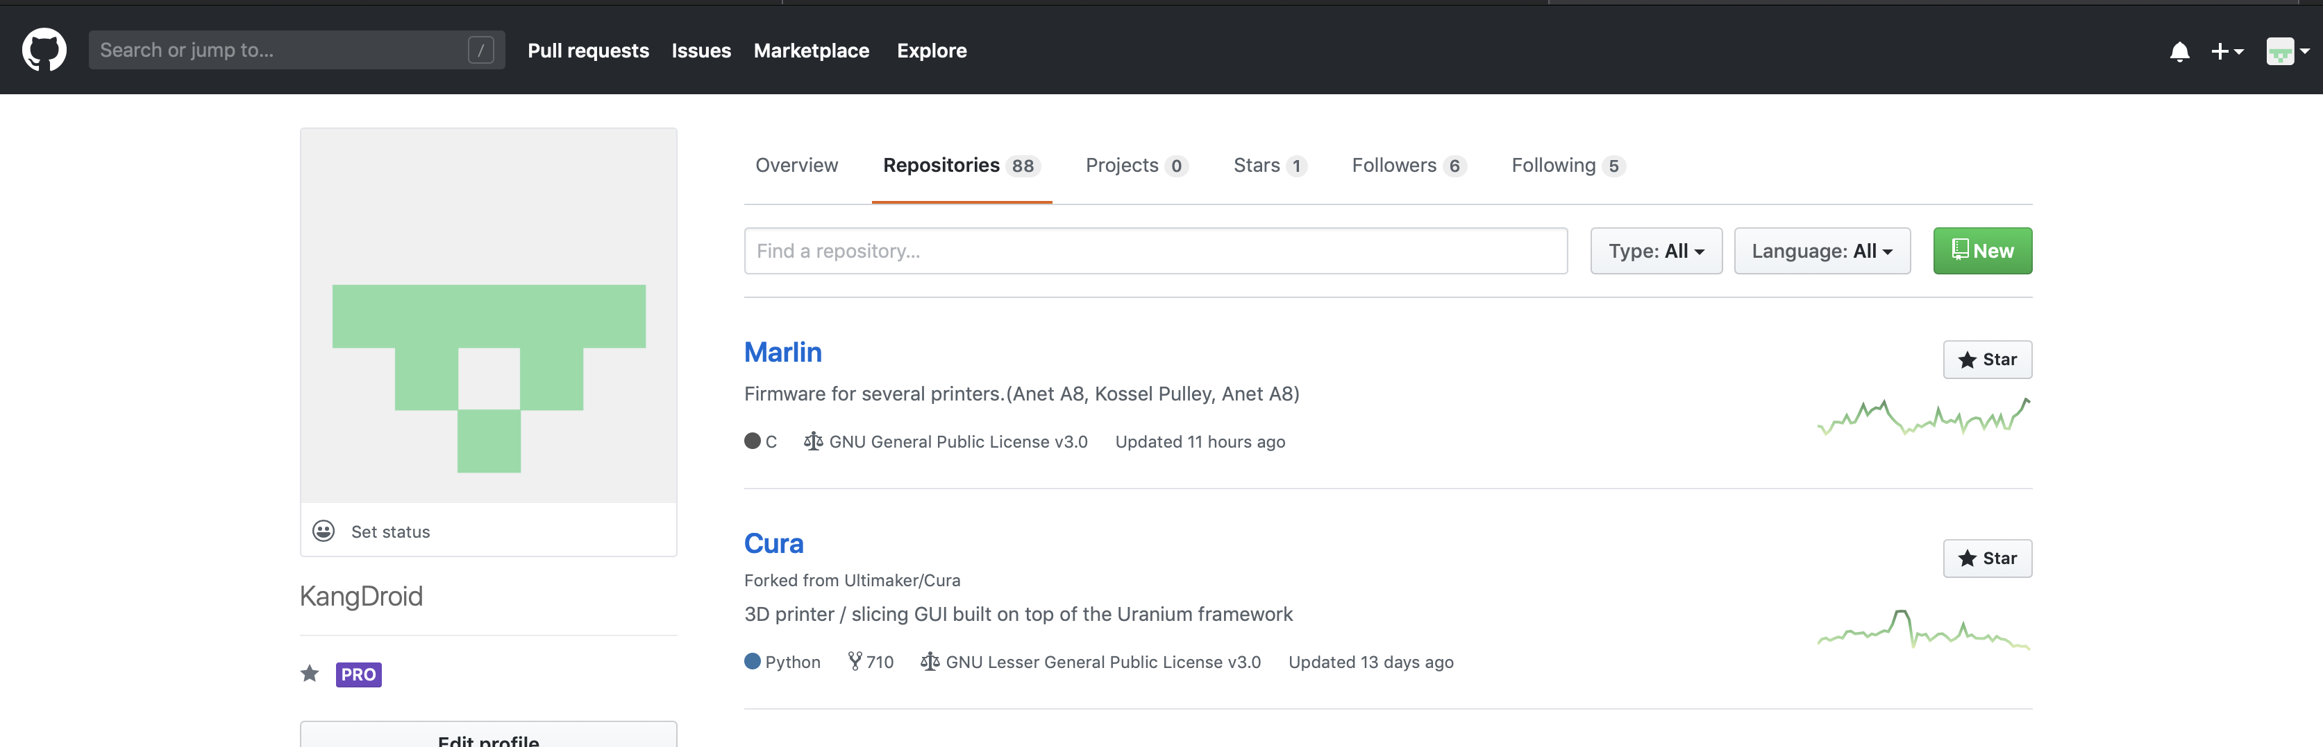
Creating Account
You will see something like this.(Similar)

Slide 6
Creating Empty Repository
Click ”New” on top-right(Red-boxed)

Slide 7
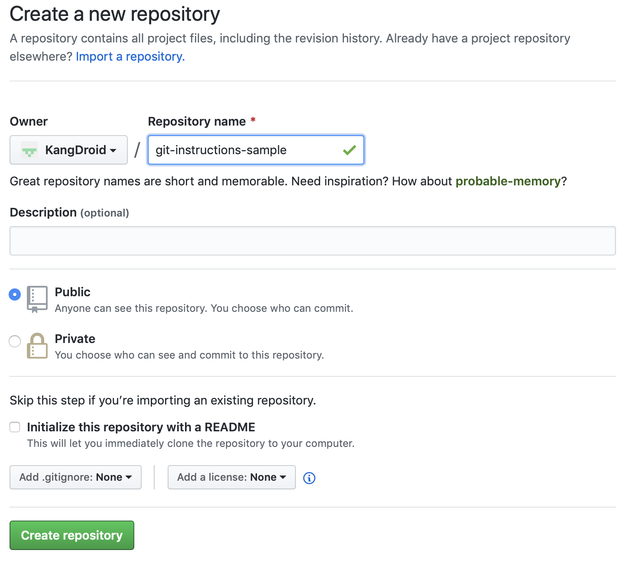
Creating Empty Repository
Set repository name(It should be rememberable to you!)

Slide 8
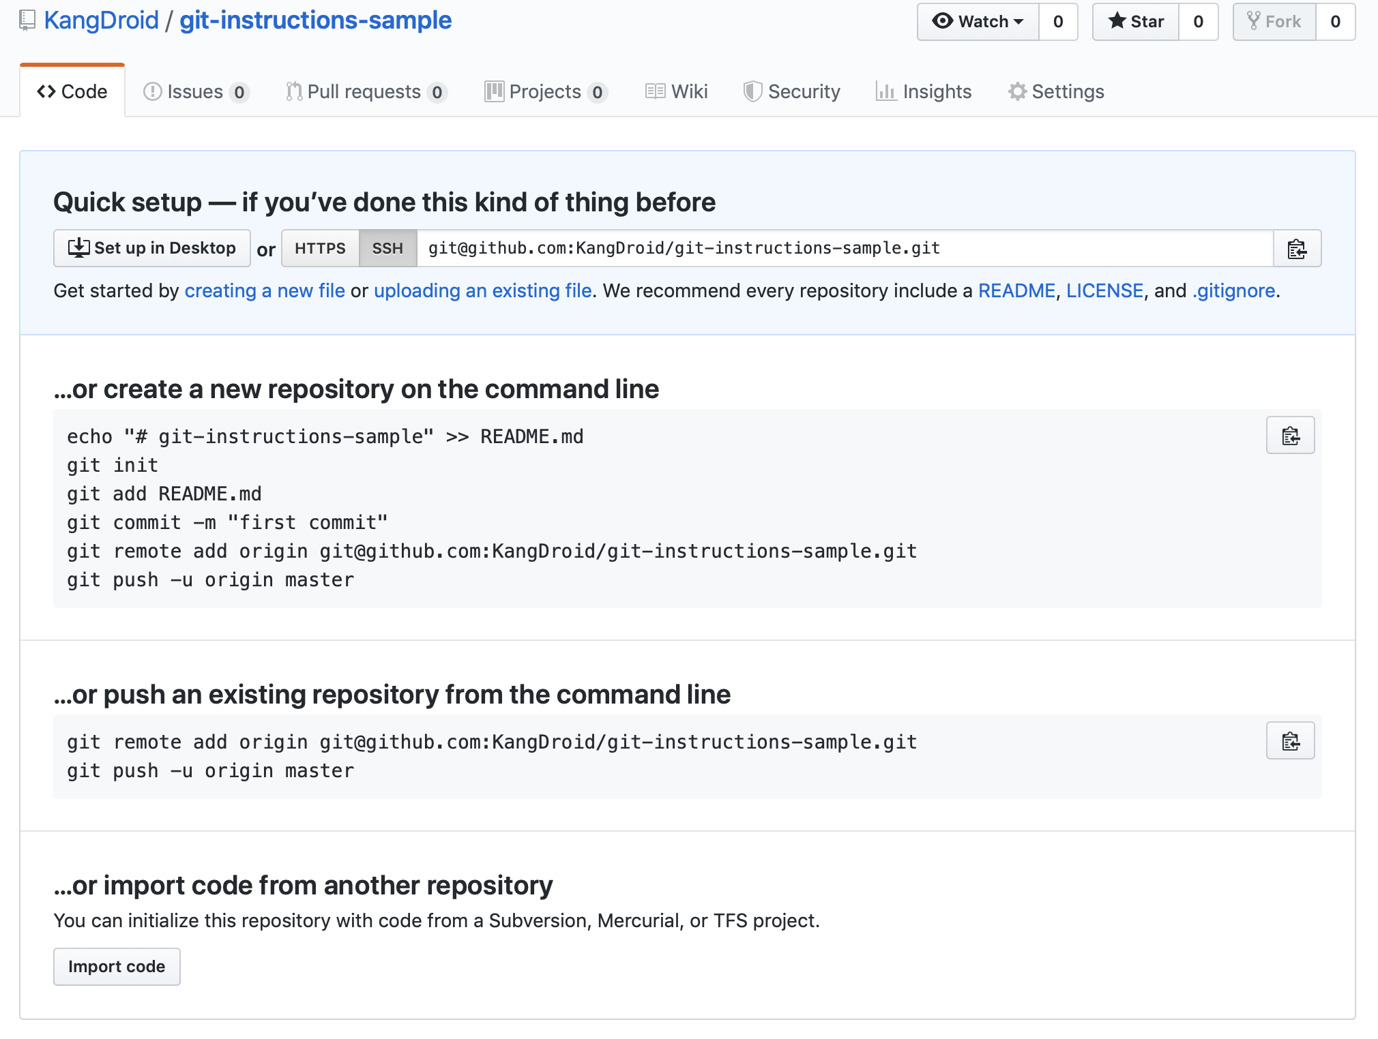
Creating Empty Repository
Creating repository and it should looks like this!

